Slide 1


Christopher Prior
21/11/2025

Slide 2

Outline
Executive Summary
Introduction
Methodology
Results
Conclusion
Appendix

Slide 3
Executive Summary
Summary of methodologies
Data collection via SpaceX REST API and web scraping
Data wrangling and preprocessing
Exploratory Data Analysis (EDA) using visualization and SQL
Interactive visual analytics using Folium and Plotly Dash
Predictive analysis using classification models (Logistic Regression, SVM, Decision Tree, KNN)
Summary of all results
- Successfully collected and processed SpaceX launch data
- Identified key factors affecting landing success (Flight Number, Payload Mass, Orbit Type, Launch Site)
- Built and evaluated multiple classification models
- Achieved best model accuracy - [Will be determined after running the models]

Slide 4
Introduction
Project background and context
- SpaceX advertises Falcon 9 rocket launches at $62 million vs. competitors at $165+ million
- Cost savings come from reusing the first stage
- Predicting first stage landing success helps determine launch cost
This information is valuable for competitive bidding
Problems you want to find answers to
- Can we predict if the Falcon 9 first stage will land successfully?
- What factors influence landing success?
- Which machine learning model performs best for this prediction?

Slide 5

Section 1

Slide 6
Methodology
Executive Summary
Data collection methodology -
Collected data from SpaceX REST API
Web scraped additional launch records from Wikipedia
Perform data wrangling
Data Quality Assessment - Identified and calculated percentage of missing values (e.g., LandingPad had 28.89% missing values)
Data Type Identification - Classified columns as numerical (FlightNumber, PayloadMass, Flights, etc.) or categorical (BoosterVersion, Orbit, LaunchSite, etc.)
Perform exploratory data analysis (EDA) using visualization and SQL
Analyzed relationships between variables using visualizations
Performed SQL queries to extract insights
Identified patterns in launch success rates
Perform interactive visual analytics using Folium and Plotly Dash
Created interactive maps showing launch sites
Built dashboard with interactive visualizations
Perform predictive analysis using classification models
- Built and tuned multiple classification models
- Evaluated model performance using cross-validation
- Selected best performing model based on test accuracy

Slide 7
Data Collection
SpaceX REST API
Collected launch data including rocket information, payloads, launchpads, and core landing outcomes from Space X API Rest Endpoints
Web Scraping -
Extracted historical launch records from Wikipedia page "List of Falcon 9 and Falcon Heavy launches“, using beautiful soup to parse the html
Data Sources -
Rocket information (booster version, block, serial)
- Payload data (mass, orbit type)
- Launch site information (name, coordinates)
- Landing outcomes (success/failure, landing type)

Slide 8
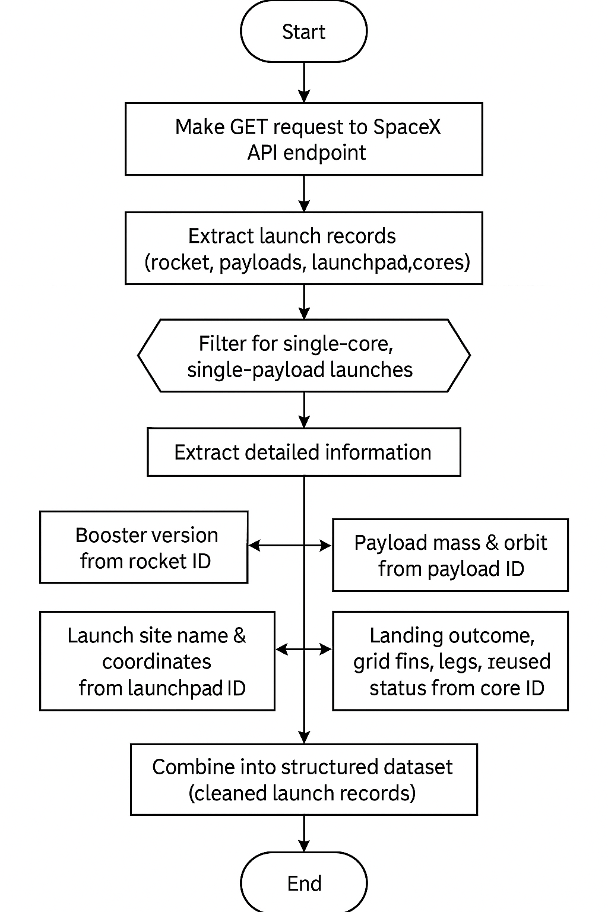
Data Collection – SpaceX API
https -//github.com/ChrisPrior96/IBM-Data-Science/blob/main/Applied%20Data%20Science%20Capstone/Lab%201/jupyter-labs-spacex-data-collection-api%20(1).ipynb

Slide 9
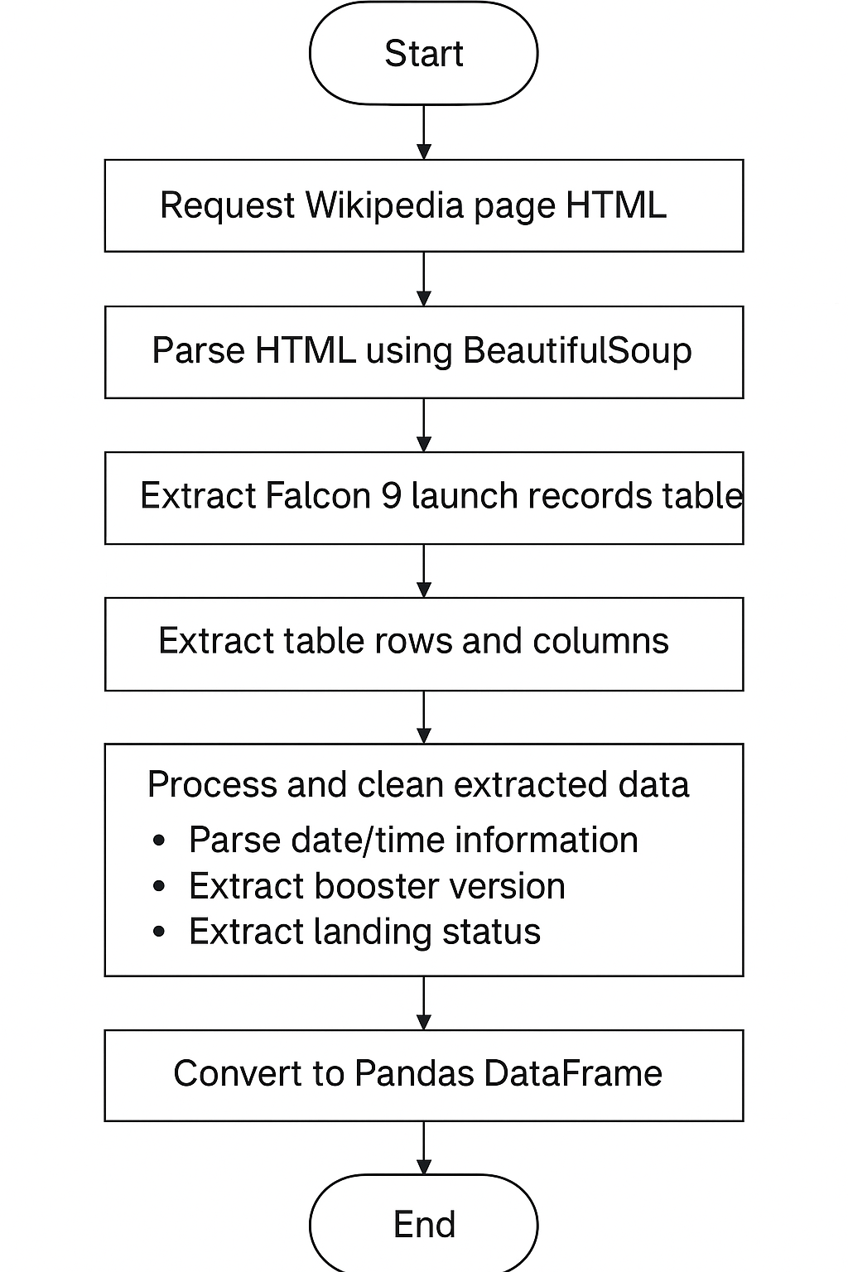
Data Collection - Scraping
https -//github.com/ChrisPrior96/IBM-Data-Science/blob/main/Applied%20Data%20Science%20Capstone/Lab%202/jupyter-labs-webscraping.ipynb

Slide 10
Data Wrangling
Data Cleaning
- Removed rows with missing critical data
- Filtered for single-core, single-payload launches
- Converted date formats to datetime
- Handled missing values
Data Transformation
- Extracted nested JSON data from API responses
- Created binary classification column (Class - 1 for success, 0 for failure)
- Standardized categorical variables
- Created dummy variables for categorical features
Feature Engineering
- Selected relevant features - FlightNumber, PayloadMass, Orbit, LaunchSite, Flights, GridFins, Reused, Legs, LandingPad, Block, ReusedCount, Serial
- Encoded categorical variables
- Standardized numerical features
https -//github.com/ChrisPrior96/IBM-Data-Science/blob/main/Applied%20Data%20Science%20Capstone/Lab%203/labs-jupyter-spacex-Data%20wrangling.ipynb

Slide 11
EDA with Data Visualization
Charts plotted and why
1. Flight Number vs. Payload Mass - To identify relationship between launch experience and payload capacity
2. Flight Number vs. Launch Site - To see if success rate improves with experience at each site
3. Payload Mass vs. Launch Site - To understand payload capacity differences across sites
4. Success Rate by Orbit Type (Bar Chart) - To identify which orbits have highest success rates
5. Flight Number vs. Orbit Type - To see if experience affects success differently by orbit
6. Payload Mass vs. Orbit Type - To understand payload constraints by orbit
7. Yearly Success Trend (Line Chart) - To observe improvement in success rate over time
Key Findings
Success rate increases with flight number (more experience = better success)
VAFB-SLC has no heavy payload launches (>10,000 kg)
LEO orbit shows relationship between flight number and success
Success rate has been increasing since 2013
https -//github.com/ChrisPrior96/IBM-Data-Science/blob/main/Applied%20Data%20Science%20Capstone/Lab%204/jupyter-labs-eda-sql-coursera_sqllite.ipynb

Slide 12
EDA with SQL
SQL Queries Performed
1. Unique Launch Sites - `SELECT DISTINCT "Launch_Site" FROM SPACEXTABLE`
2. Launch Sites Beginning with 'CCA' - `SELECT * FROM SPACEXTABLE WHERE "Launch_Site" LIKE 'CCA%' LIMIT 5`
3. Total Payload Mass for NASA (CRS) - `SELECT SUM("PAYLOAD_MASS__KG_") FROM SPACEXTABLE WHERE "Customer" = 'NASA (CRS)'`
4. Average Payload Mass for F9 v1.1 - `SELECT AVG("PAYLOAD_MASS__KG_") FROM SPACEXTABLE WHERE "Booster_Version" = 'F9 v1.1'`
5. First Successful Ground Landing - `SELECT MIN("Date") FROM SPACEXTABLE WHERE "Landing_Outcome" = 'Success (ground pad)'`
6. Successful Drone Ship with Payload 4000-6000 - `SELECT "Booster_Version" FROM SPACEXTABLE WHERE "Landing_Outcome" = 'Success (drone ship)' AND "PAYLOAD_MASS__KG_" > 4000 AND "PAYLOAD_MASS__KG_" < 6000`
7. Total Success/Failure Count - `SELECT "Mission_Outcome", COUNT(*) as Count FROM SPACEXTABLE GROUP BY "Mission_Outcome"`
8. Maximum Payload Boosters - `SELECT "Booster_Version" FROM SPACEXTABLE WHERE "PAYLOAD_MASS__KG_" = (SELECT MAX("PAYLOAD_MASS__KG_") FROM SPACEXTABLE)`
9. 2015 Failure Records - `SELECT substr("Date", 6, 2) as Month, "Landing_Outcome", "Booster_Version", "Launch_Site" FROM SPACEXTABLE WHERE substr("Date", 0, 5) = '2015' AND "Landing_Outcome" LIKE 'Failure (drone ship)%'`
10. Ranked Landing Outcomes (2010-2017) - `SELECT "Landing_Outcome", COUNT(*) as Count FROM SPACEXTABLE WHERE "Date" >= '2010-06-04' AND "Date" <= '2017-03-20' GROUP BY "Landing_Outcome" ORDER BY Count DESC`
https://github.com/ChrisPrior96/IBM-Data-Science/blob/main/Applied%20Data%20Science%20Capstone/Lab%205/edadataviz.ipynb

Slide 13
Build an Interactive Map with Folium
Map objects created
Launch Site Markers: Added markers for all launch sites (CCAFS LC-40, CCAFS SLC-40, KSC LC-39A, VAFB SLC-4E)
Color-coded Markers: Different colours for successful vs. failed landings
Circle Markers: Radius proportional to payload mass
Distance Calculations: Calculated distances to nearby features (railway, highway, coastline)
Why added
- Visualize geographic distribution of launch sites
- Identify patterns in success rates by location
- Understand proximity to infrastructure
- Provide interactive exploration of launch data
https://github.com/ChrisPrior96/IBM-Data-Science/blob/main/Applied%20Data%20Science%20Capstone/Lab%206/lab_jupyter_launch_site_location.ipynb

Slide 14
Build a Dashboard with Plotly Dash
Plots/graphs and interactions
Pie Chart: Launch success count for all sites
Pie Chart: Launch site with highest success ratio
Scatter Plot: Payload vs. Launch Outcome with range slider
Interactive Filters: Launch site dropdown, payload range slider, booster version selector
Why added
- Enable interactive exploration of data
- Allow users to filter by different criteria
- Visualize relationships between variables
- Identify patterns in success rates by payload range and booster version
https://github.com/ChrisPrior96/IBM-Data-Science/blob/main/Applied%20Data%20Science%20Capstone/Lab%207/spacex-dash-app.py

Slide 15
Predictive Analysis (Classification)
Model Development Process
1. Data Preparation:
Standardized features using StandardScaler
Split data: 80% training, 20% testing
Created binary target variable (Class: 1=success, 0=failure)
2. Model Building:
Logistic Regression with GridSearchCV (C: [0.01, 0.1, 1], penalty: l2, solver: lbfgs)
Support Vector Machine with GridSearchCV (kernel: linear/rbf/poly/sigmoid, C: logspace(-3,3,5), gamma: logspace(-3,3,5))
Decision Tree with GridSearchCV (criterion: gini/entropy, max_depth: 2-18, min_samples_leaf: 1-4, min_samples_split: 2-10)
K-Nearest Neighbors with GridSearchCV (n_neighbors: 1-10, algorithm: auto/ball_tree/kd_tree/brute, p: 1-2)
3. Model Evaluation:
Used 10-fold cross-validation for hyperparameter tuning
Evaluated on test set using accuracy score
Generated confusion matrices for each model
4. Best Model Selection:
Compared test accuracies across all models
Selected model with highest test accuracy
https://github.com/ChrisPrior96/IBM-Data-Science/blob/main/Applied%20Data%20Science%20Capstone/Lab%208/SpaceX_Machine%20Learning%20Prediction_Part_5.ipynb

Slide 16
Results
Exploratory data analysis results:
Success rate increases with flight number (experience matters)
Payload mass affects success rate
Orbit type influences landing success
Launch site location impacts success
Success rate has improved over time (2013-2020)
Predictive analysis results
Logistic Regression Test Accuracy: 0.8333333333333334
SVM Test Accuracy: 0.8333333333333334
Decision Tree Test Accuracy: 0.8333333333333334
KNN Test Accuracy: 0.8333333333333334
Best Method: Logistic Regression with accuracy: 0.8333333333333334

Slide 17

Section 2

Slide 18
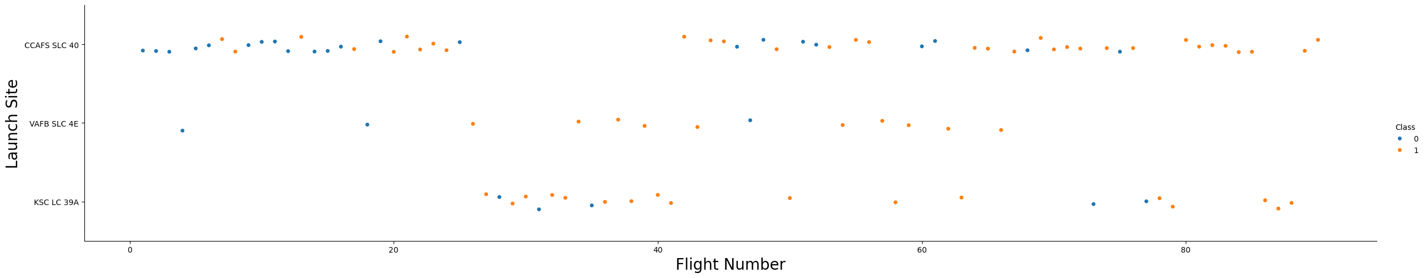
Flight Number vs. Launch Site
Success rate improves with flight number, especially at certain launch sites

Slide 19
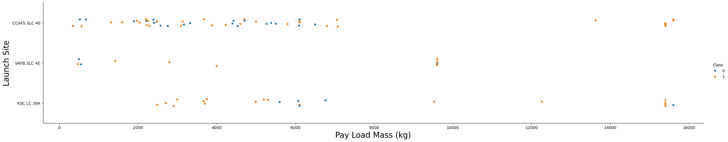
Payload vs. Launch Site
VAFB-SLC has no heavy payload launches; payload affects success differently by site

Slide 20
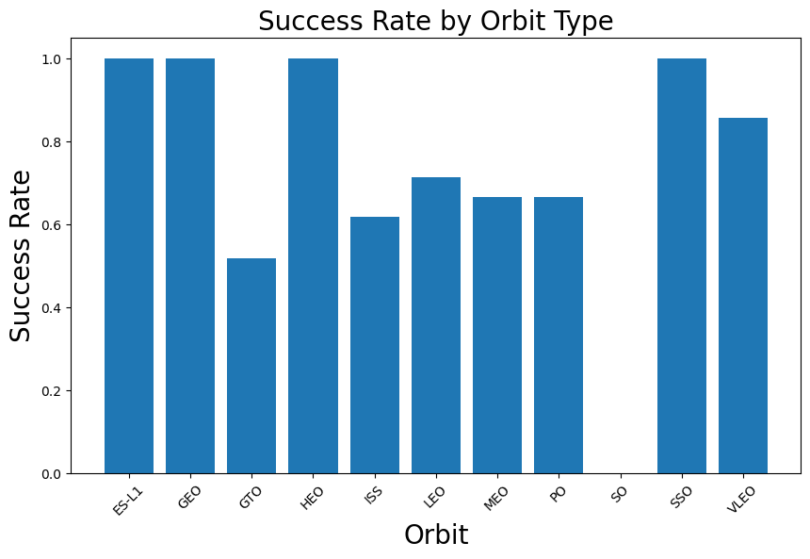
Success Rate vs. Orbit Type
Highest Success Rate
ES-L1
GEO
HEO
SSO

Slide 21
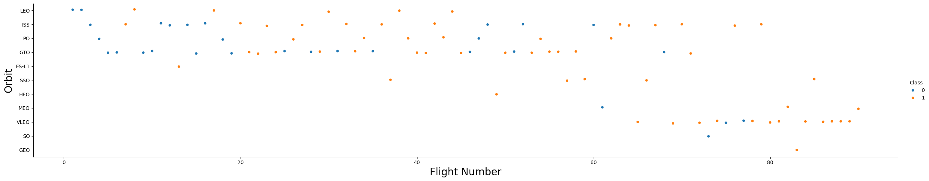
Flight Number vs. Orbit Type
EO Shows no real relationship between flight number and success; GTO shows no clear relationship

Slide 22
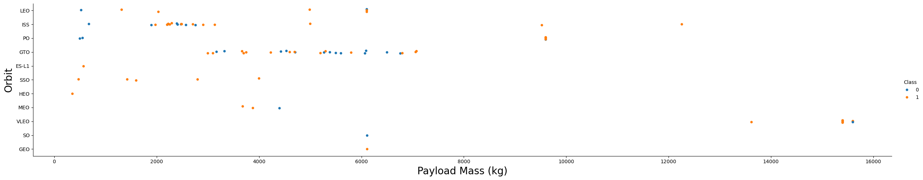
Payload vs. Orbit Type
Different orbits have different payload constraints and success patterns

Slide 23
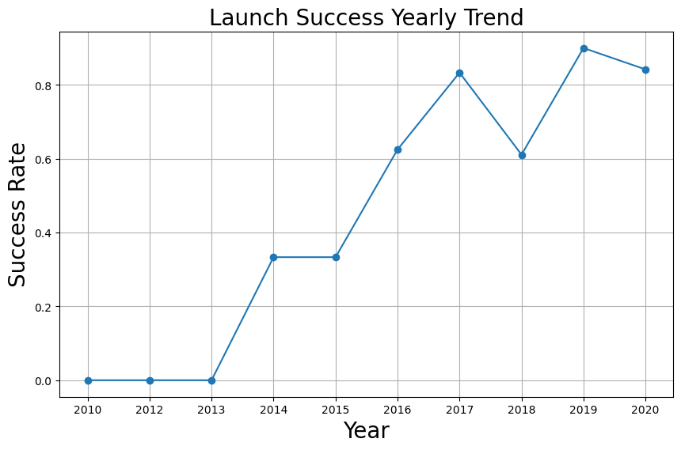
Launch Success Yearly Trend
Success rate has been increasing since 2013, reaching peak in 2020

Slide 24
All Launch Site Names
Query: `SELECT DISTINCT "Launch_Site" FROM SPACEXTABLE`
Result: CCAFS LC-40, CCAFS SLC-40, KSC LC-39A, VAFB SLC-4E

Slide 25
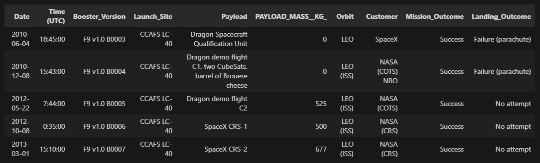
Launch Site Names Begin with 'CCA'
%sql SELECT * FROM SPACEXTABLE WHERE "Launch_Site" LIKE 'CCA%' LIMIT 5

Slide 26
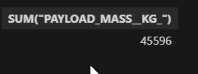
Total Payload Mass
%sql SELECT SUM("PAYLOAD_MASS__KG_") FROM SPACEXTABLE WHERE "Customer" = 'NASA (CRS)'

Slide 27
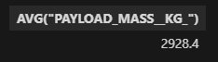
Average Payload Mass by F9 v1.1
%sql SELECT AVG("PAYLOAD_MASS__KG_") FROM SPACEXTABLE WHERE "Booster_Version" = 'F9 v1.1'

Slide 28

First Successful Ground Landing Date
%sql SELECT MIN("Date") FROM SPACEXTABLE WHERE "Landing_Outcome" = 'Success (ground pad)'

Slide 29
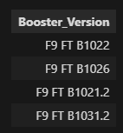
Successful Drone Ship Landing with Payload between 4000 and 6000
%sql SELECT "Booster_Version" FROM SPACEXTABLE WHERE "Landing_Outcome" = 'Success (drone ship)' AND "PAYLOAD_MASS__KG_" > 4000 AND "PAYLOAD_MASS__KG_" < 6000

Slide 30
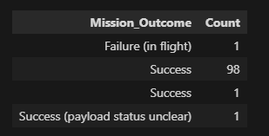
Total Number of Successful and Failure Mission Outcomes
%sql SELECT "Mission_Outcome", COUNT(*) as Count FROM SPACEXTABLE GROUP BY "Mission_Outcome"

Slide 31
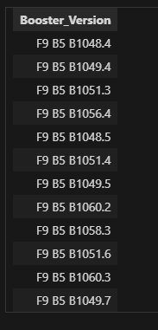
Boosters Carried Maximum Payload
%sql SELECT "Booster_Version" FROM SPACEXTABLE WHERE "PAYLOAD_MASS__KG_" = (SELECT MAX("PAYLOAD_MASS__KG_") FROM SPACEXTABLE)

Slide 32
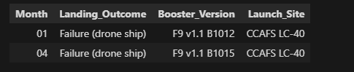
2015 Launch Records
%sql SELECT substr("Date", 6, 2) as Month, "Landing_Outcome", "Booster_Version", "Launch_Site" FROM SPACEXTABLE WHERE substr("Date", 0, 5) = '2015' AND "Landing_Outcome" LIKE 'Failure (drone ship)%'

Slide 33
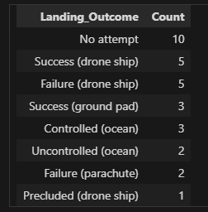
Rank Landing Outcomes Between 2010-06-04 and 2017-03-20
%sql SELECT "Landing_Outcome", COUNT(*) as Count FROM SPACEXTABLE WHERE "Date" >= '2010-06-04' AND "Date" <= '2017-03-20' GROUP BY "Landing_Outcome" ORDER BY Count DESC

Slide 34

Section 3

Slide 35
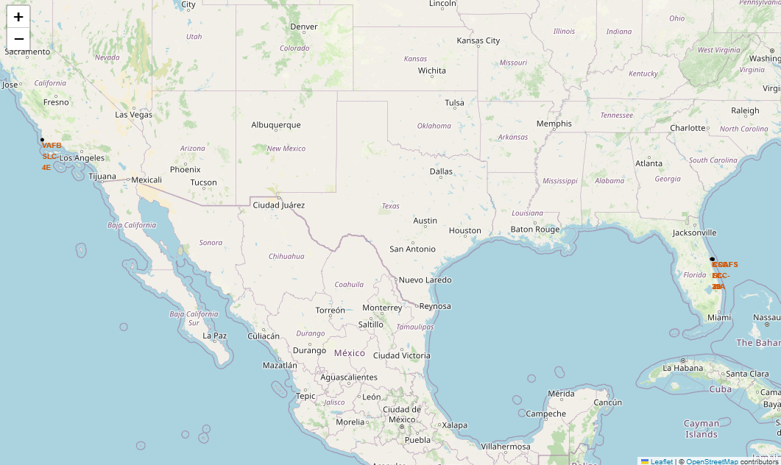
All Launch Sites

Slide 36
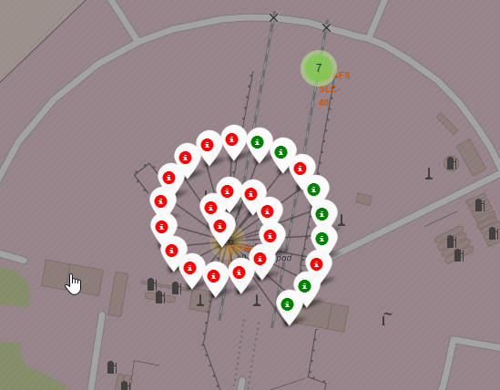
Colour coded Launch Site Map

Slide 37
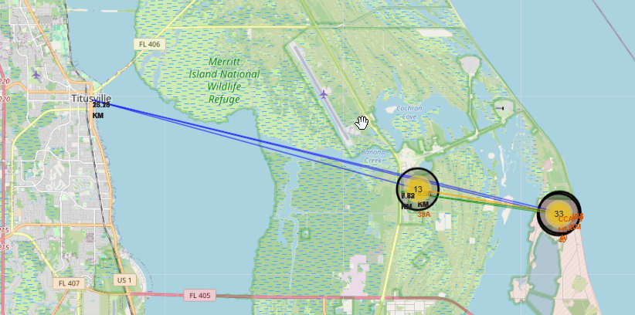
Distances between a launch site to its proximities

Slide 38

Section 4

Slide 39
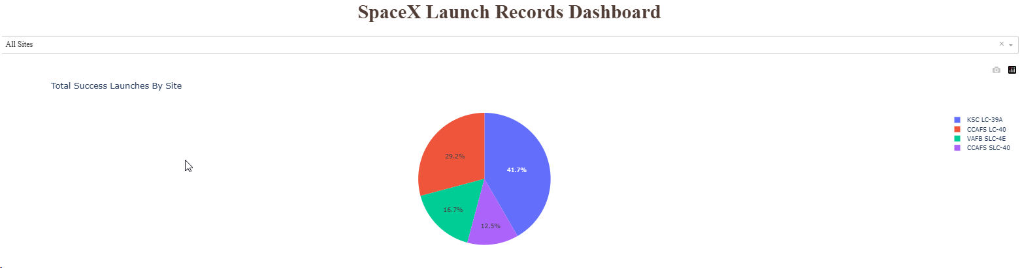
Total Success by Site
KSC LC-39A is the most successfull

Slide 40
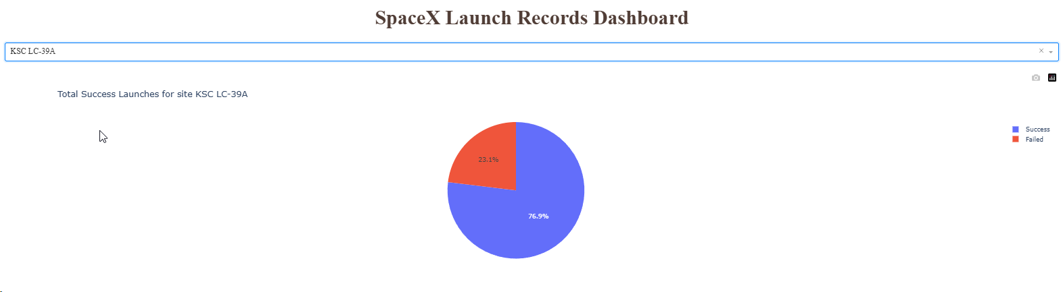
Total Successful Launches for site KSC LC-39A

Slide 41
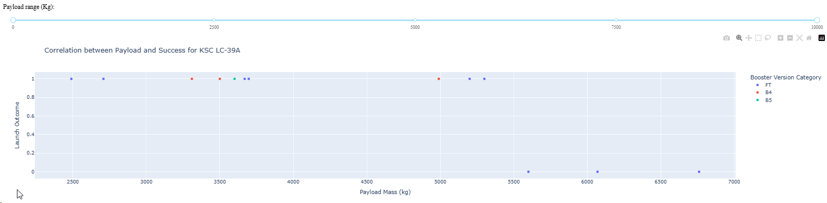
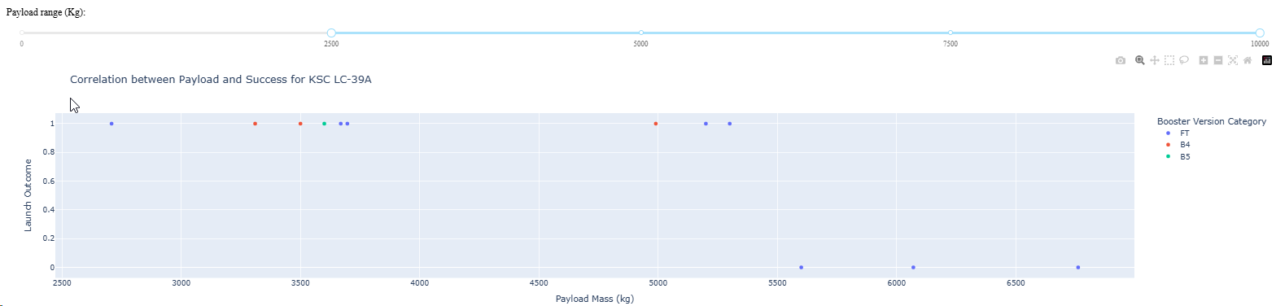
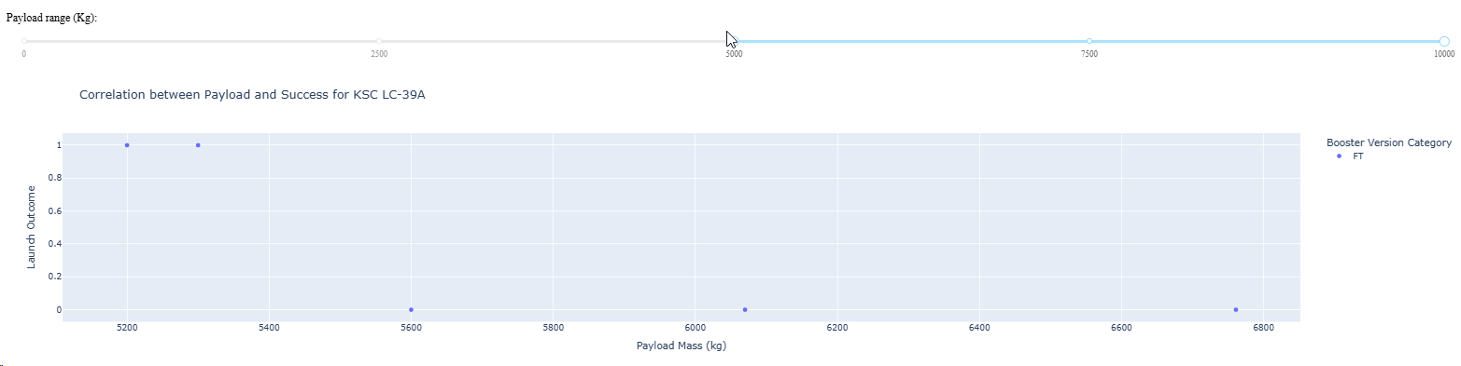
Correlation between payload and Success for KSC-LC-39A

Slide 42

Section 5

Slide 43
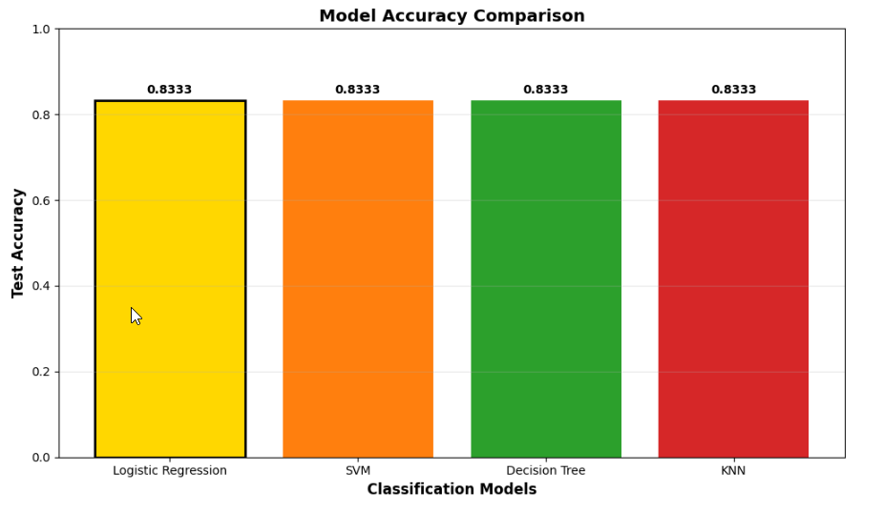
Classification Accuracy

Slide 44

Confusion Matrix
True Positives: Correctly predicted successful landings
False Positives: Incorrectly predicted successful landings
True Negatives: Correctly predicted failed landings
False Negatives: Incorrectly predicted failed landings

Slide 45
Conclusions
Flight number (experience) is a key factor in landing success - success rate increases with more launches
Payload mass and orbit type significantly influence landing outcomes
Launch site location affects success rates, with some sites showing better performance
Machine learning models can effectively predict landing success, with Logistic Regression
achieving 83.4% accuracy

Slide 46
Appendix
Include any relevant assets like Python code snippets, SQL queries, charts, Notebook outputs, or data sets that you may have created during this project

Slide 47


